Slide 1

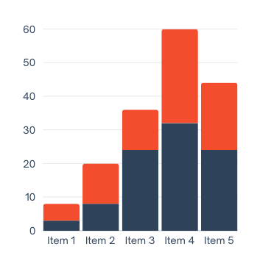


















KEY INSIGHTS:
DATA INFOGRAPHIC
Infographic makes it easier for readers to absorb chunks of information. Shortly explain here what will this infographic cover.
DATA 1
DATA 2
Include data like percentages and average. It helps the reader get insight about the topic.
Include data like percentages and average. It helps the reader get insight about the topic.
Step 1
Step 2
Step 3
Step 4
DATA 3
Step 5
Include data like percentages and average. It helps the reader get insight about the topic.
Aaron Loeb
Bailey Dupont
Manager
Staff
Francois Mercer
Kyrie Petrakis
Samira Hadid
CEO
Manager
Staff
Harper Russo
Shawn Garcia
Manager
Staff
DATA 4
DATA 5
Include data like percentages and average. It helps the reader get insight about the topic.
Include data like percentages and average. It helps the reader get insight about the topic.
67%
DATA 6
Include data like percentages and average. It helps the reader get insight about the topic.
2017
2020
2023
reallygreatsite.com

